Slide 1
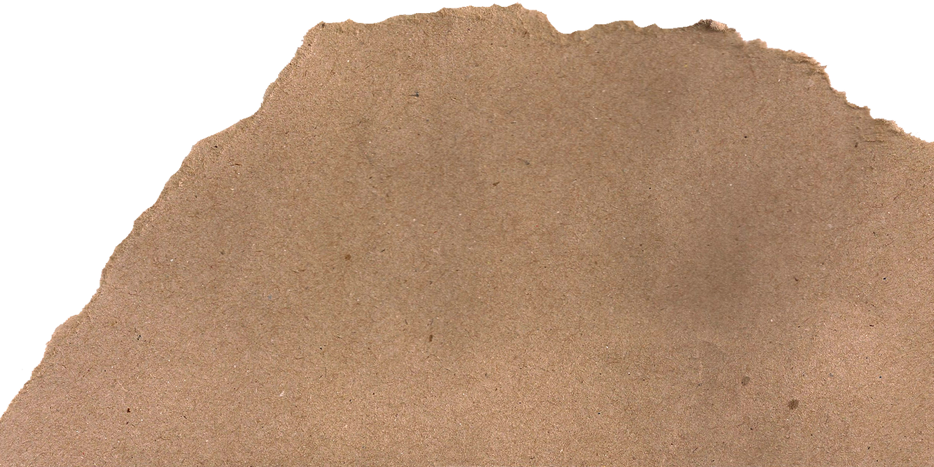

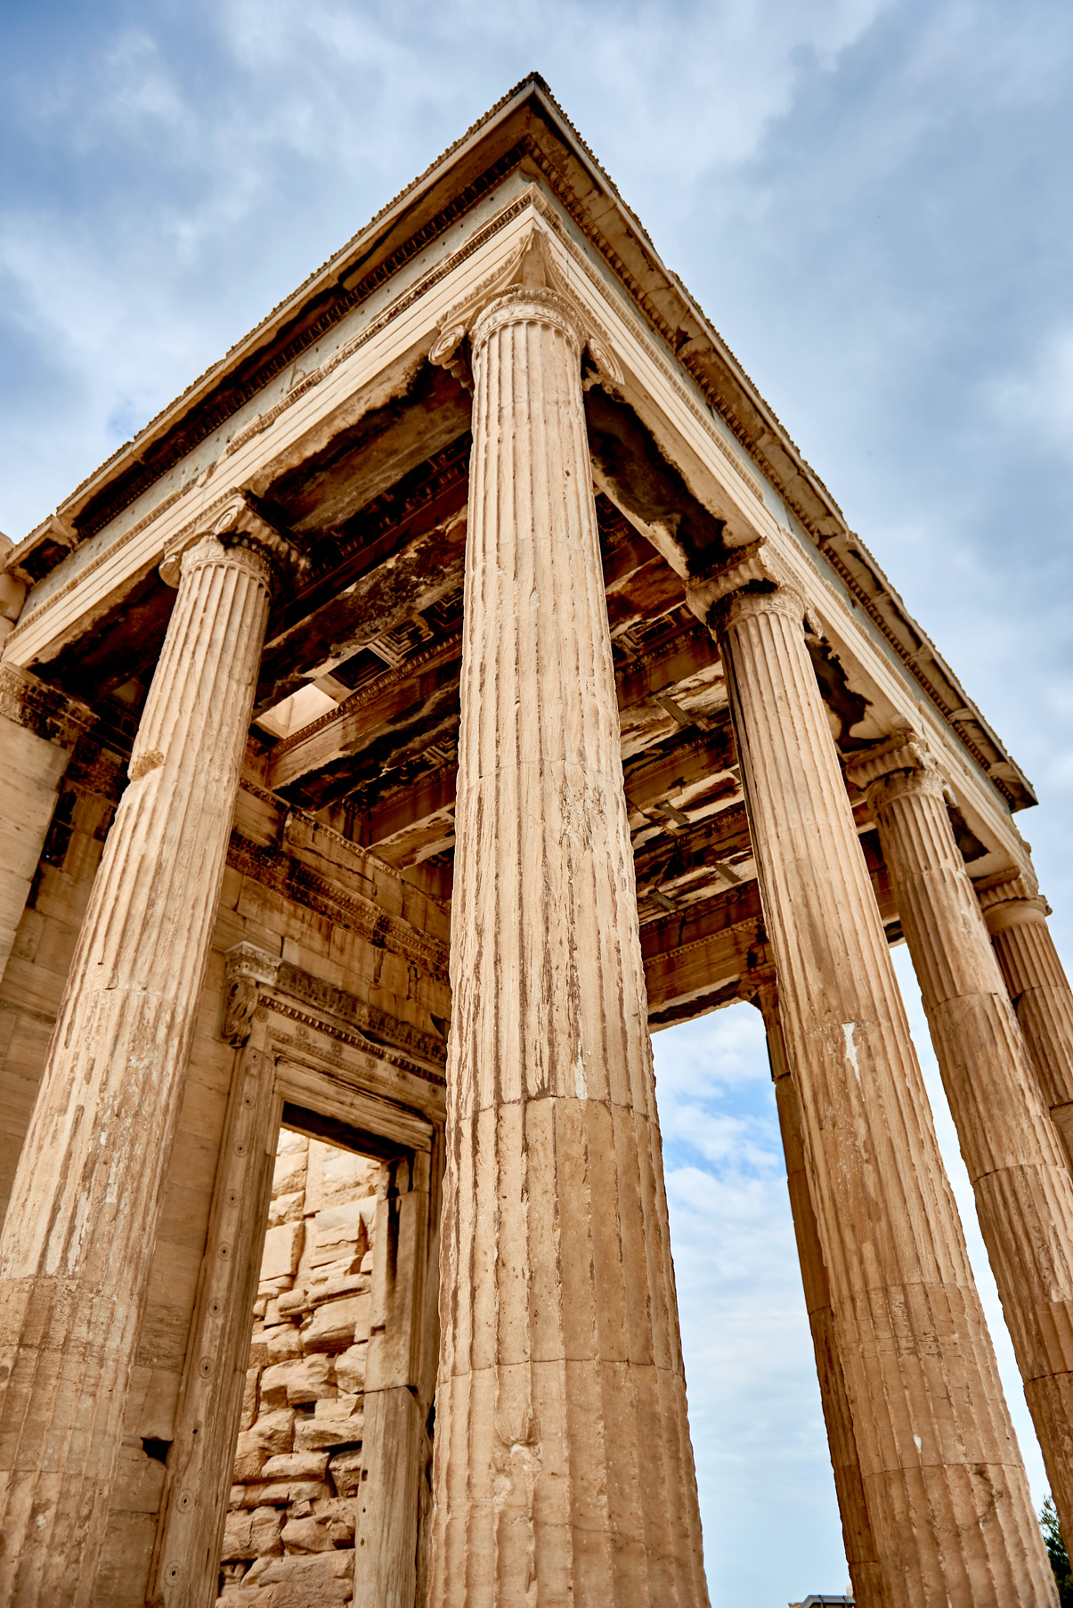
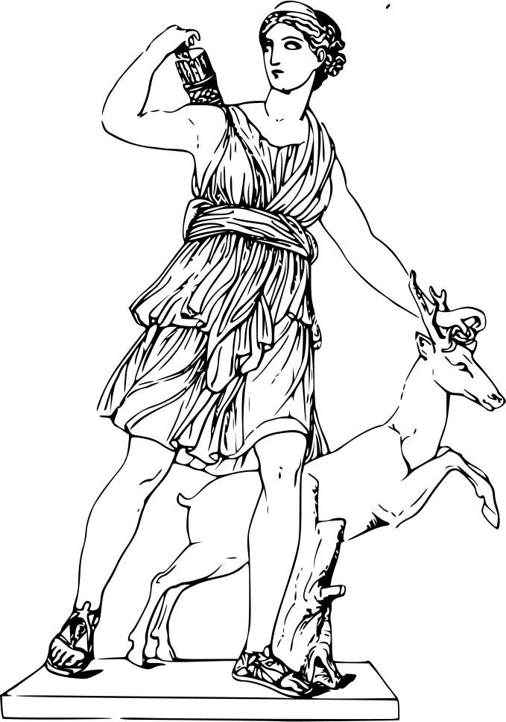
Ancient Greece

Slide 2
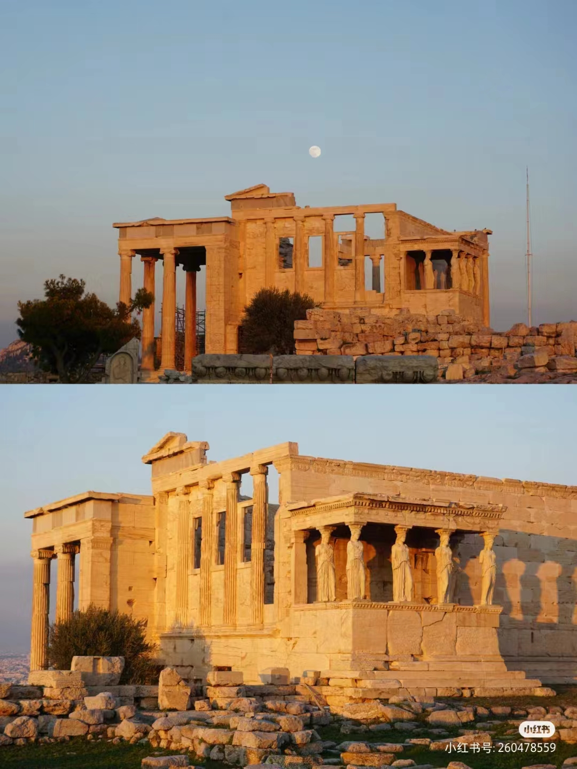
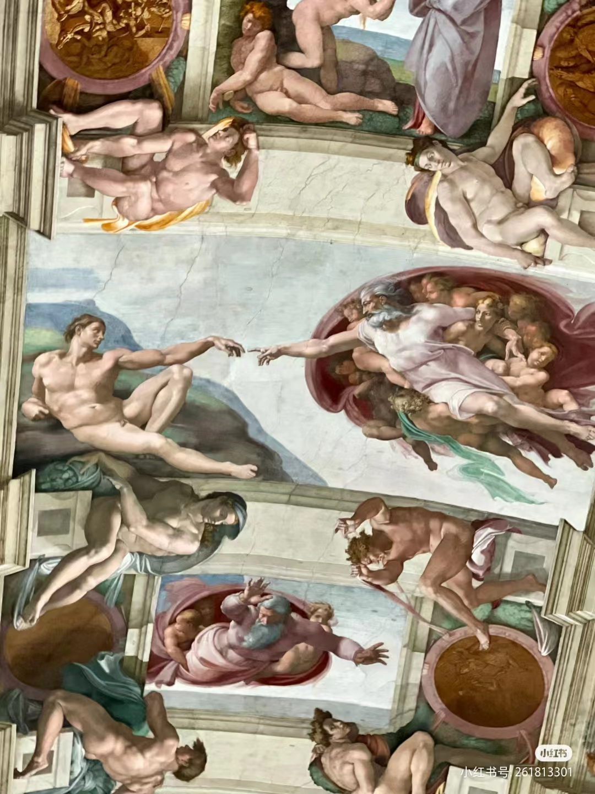
目录
一 、Introduction
二 、Geography location
三、Dates and Ancient Greek philosophy.
四、Comparison of the two civilization in the Axis era

Slide 3
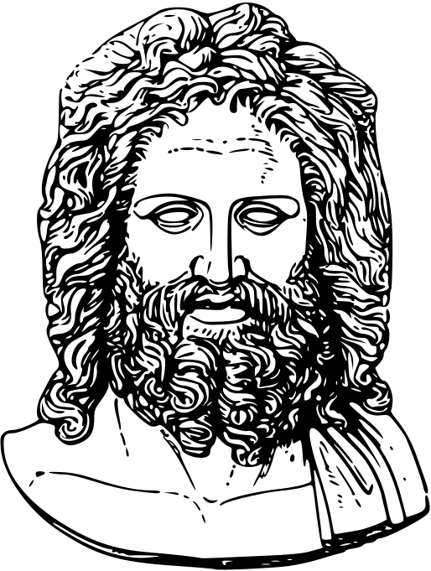
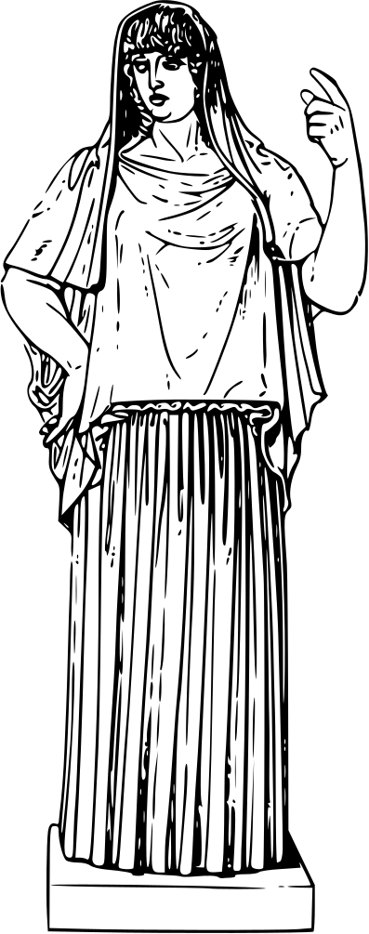
一
Introduction
Ancient Greek civilization is the cradle（摇篮） of Western civilization. Ancient Greek culture gave birth to modern European culture. Ancient Xila's literature and art had a pioneering influence on Western culture, and natural science also had a profound impact on Western science.

Slide 4
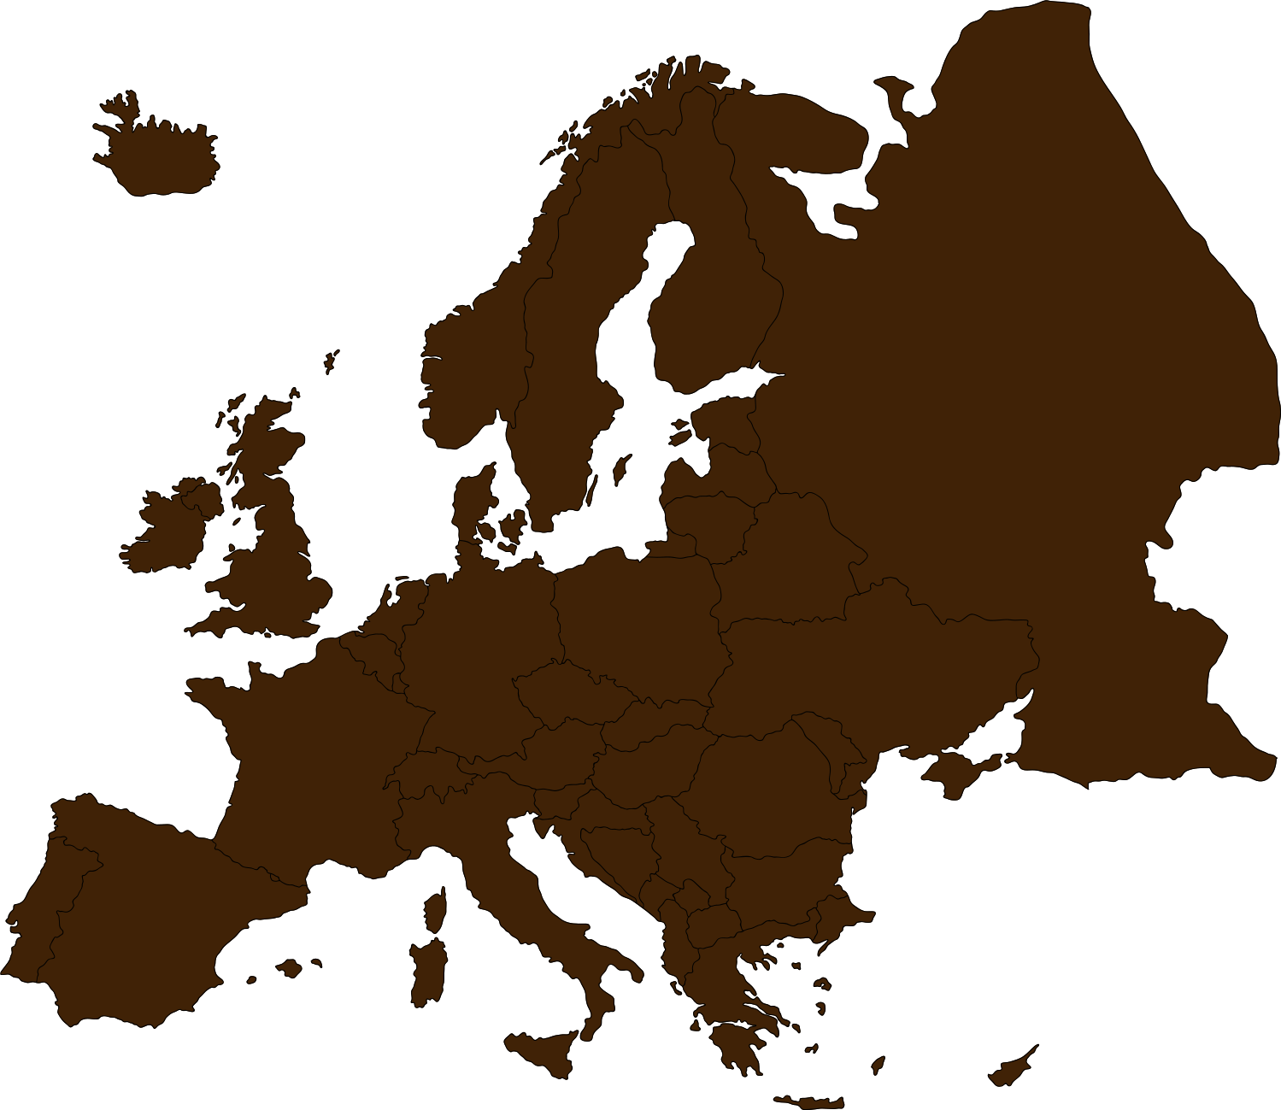


二
geography location
Greece is located in Southeast Europe, with the Aegean Sea （爱琴海）to the East, the Ionian Sea（伊奥尼亚海） to the west and the Mediterranean Sea（地中海） to the south.

Slide 5
三
Dates
Minoan
Dark
Archaic
Classic
Hellenistic
20-12th century BC.
爱琴文明或克里特，迈锡尼文明
11th-9th centuries BC..
荷马时代
8th-6th centuries BC.
古风时代
5th century BC – mid-4th century BC
古典时代
Late 5th century BC-mid 2nd century BC.
马其顿统治时代

Slide 6
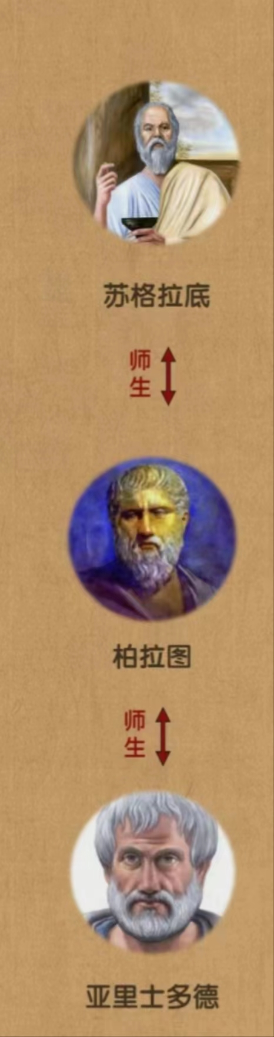
Ancient Greek philosophy.
雅典三大哲学家：
苏格拉底（公元前469年—前399年）
柏拉图（公元前428—前348年）
亚里士多德（公元前384—前322年）
亚里士多德 “我唯一知道的就是自己一无所知”
point of view:
the main task of philosophy is to explore the moral and ethical（道德和伦理） issues related to the happiness of life;
virtue is based on knowledge, and knowledge and virtue are integrated, and the two rely on education to obtain;
it is emphasized that people need to know and admit their ignorance first.
柏拉图 出身雅典显贵，政治上鬼吹斯巴达式城邦体质
point of view: Only ideas or concepts are the origin of all things. The world of ideas is real, while the material world is illusory（虚幻的）
亚里士多德 “吾爱吾师，但更爱真理”
point of view：Concepts and ideas belong to the abstraction （抽象概念）of human thinking, and objectively there is no existence of a world of ideas

Slide 7
Comparison between Ancient Greek Philosophy and Chinese Philosophy of the Same Period.
Ancient Greek philosophy pays attention to rational (理性的）thinking and logical analysis, and pursues the profound（深刻的） disclosure（揭示） of the truth of the universe and the essence（本质） of human life.For example, Plato's （柏拉图）theory of ideas emphasizes the importance of rational understanding, and believes that only through rationality can we really understand the essence of things.Compared with this, Chinese philosophy of the same period pays more attention to morality and ethics, emphasizing the harmony and stability of individual behavior and social order.Ancient Chinese philosophy, such as Confucianism, paid attention to moral cultivation and the relationship between people, and emphasized the guidance of behavior based on moral principles

Slide 8
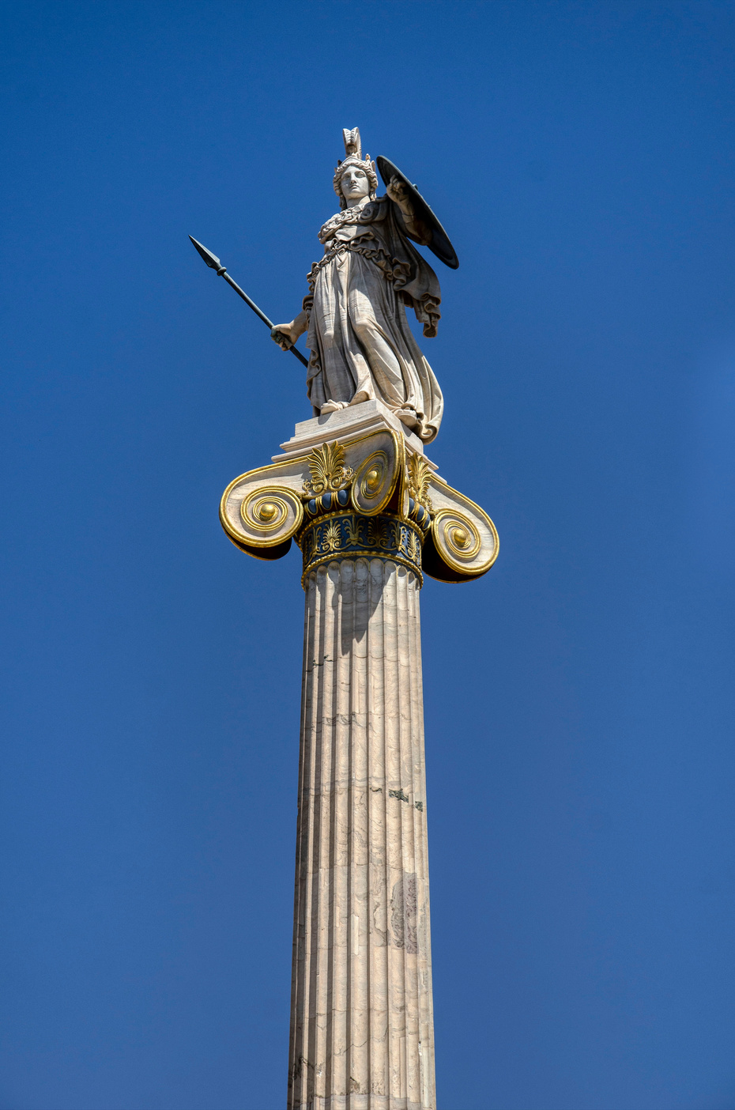
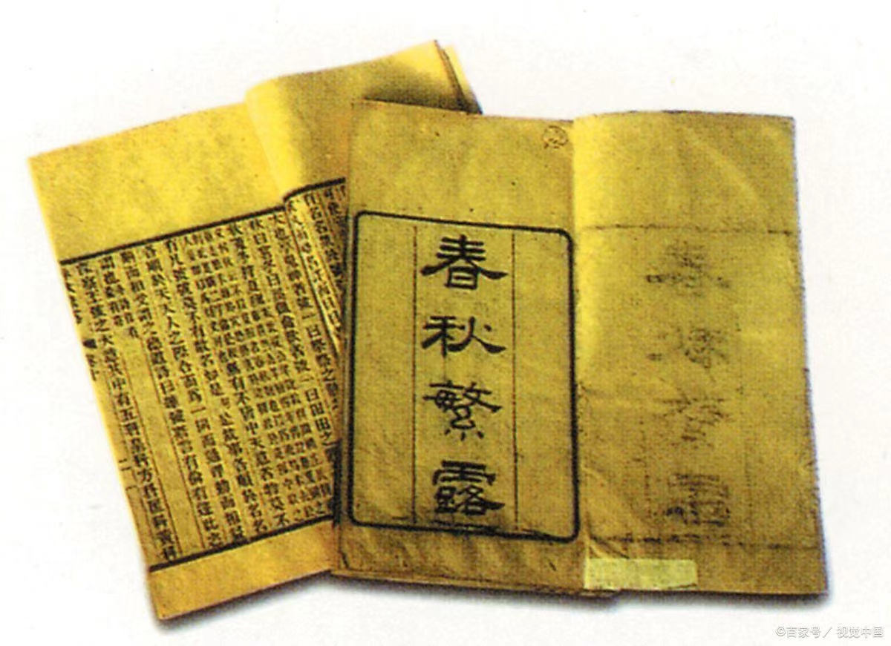
四
Comparison of the two civilizations in the Axis era（轴心时代）
Spring and Autumn Period and Warring States Period
Ancient Greece
VS

Slide 9
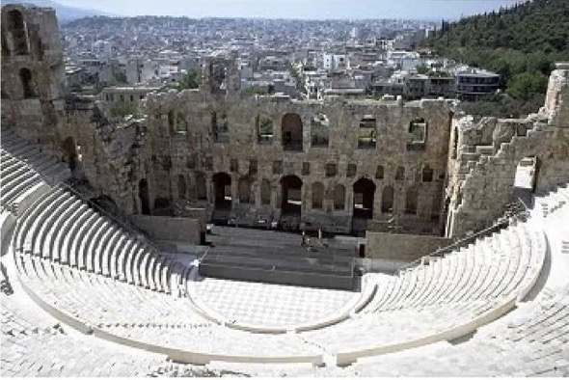
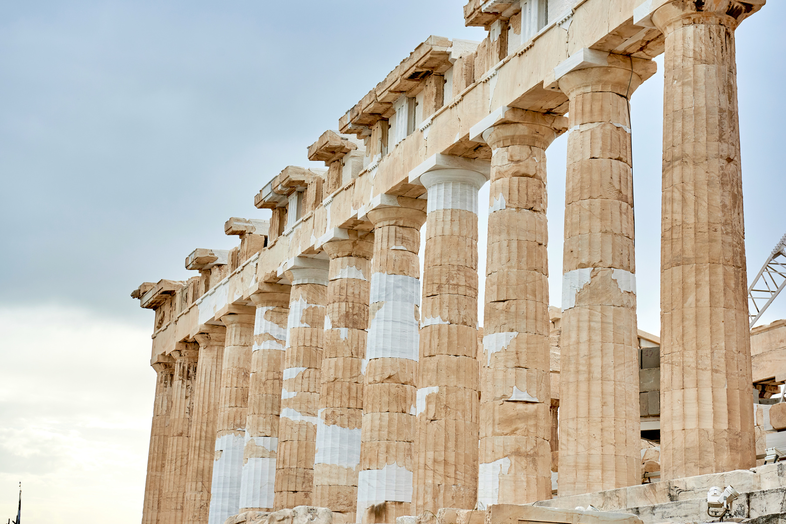
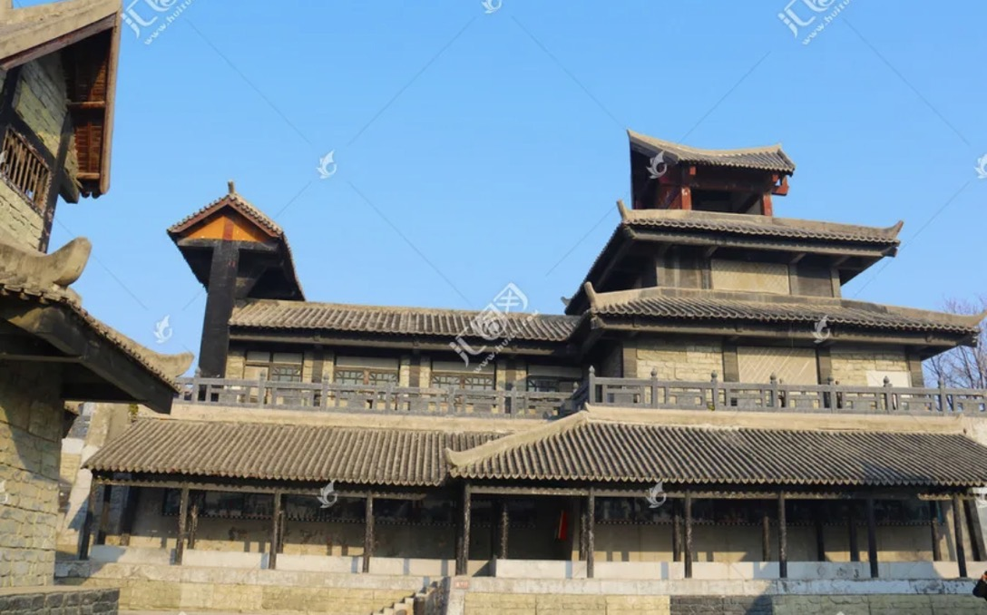
Building
·Column （柱式）buildings are very popular.
·Religious color is bright.
·Pay attention to the construction of public places
·Use a lot of bricks and tiles
·The appearance of high-rise buildings
·The rise of urban planning （城市规划）concepts
多立克柱式

Slide 10
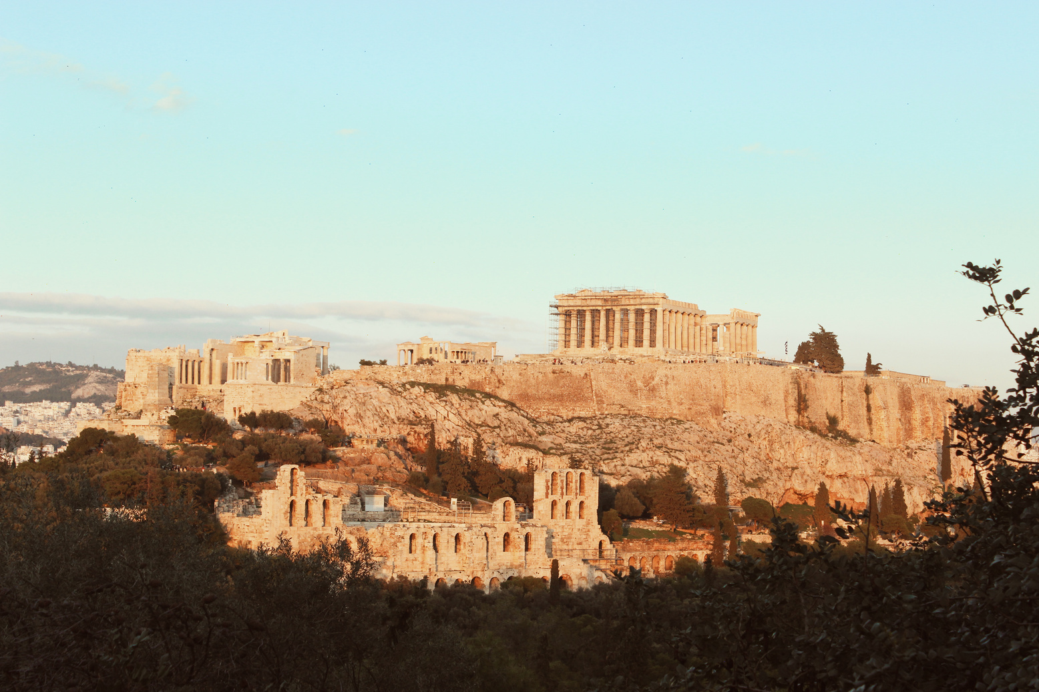
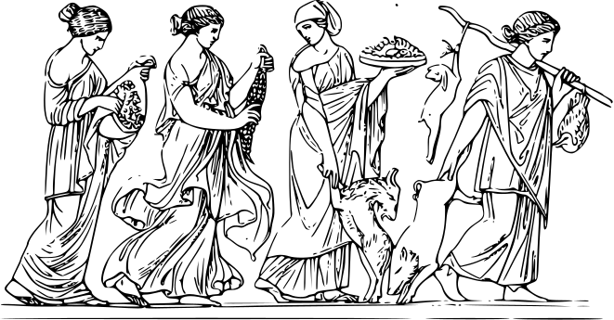
Politics
The transition from slavery to feudalism（奴隶制向封建制转型）：
The royal family declines, and the princes compete for hegemony（霸权）.
The emerging landlord class （新型地主阶级）is gradually developing and growing.
Slavery（奴隶制）：Some city-states, such as Sparta（斯巴达）, practice a monarchy （君主制）and concentrate their rule in the hands of the king.
Some city-states, such as Athens（雅典）, practice democracy（民主政治）.
And some city-states are ruled by nobles or by a few-controlled parliaments(议会）.

Slide 11

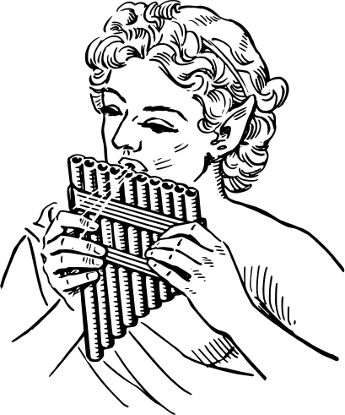
Thought
In ancient Greece, people attached great importance to individual freedom and independence（个人自由与独立）, and emphasized equality and respect among individuals.
Socrates said: Know yourself.
认识你自己
Chinese culture pays attention to the overall interests of family and society, and believes that individuals should obey the needs of the collective（个人服从集体）.
Confucius said: Self-rescerning is benevolent.
克己复礼为仁

Slide 12
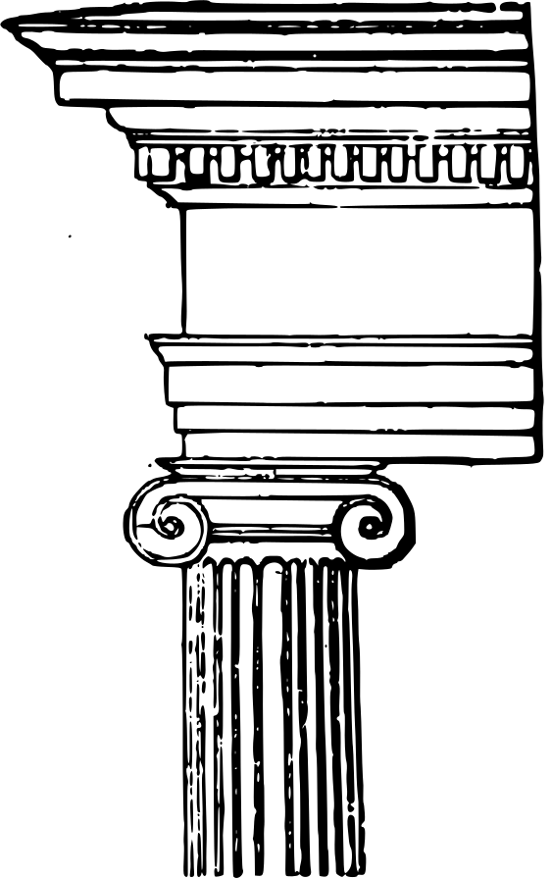
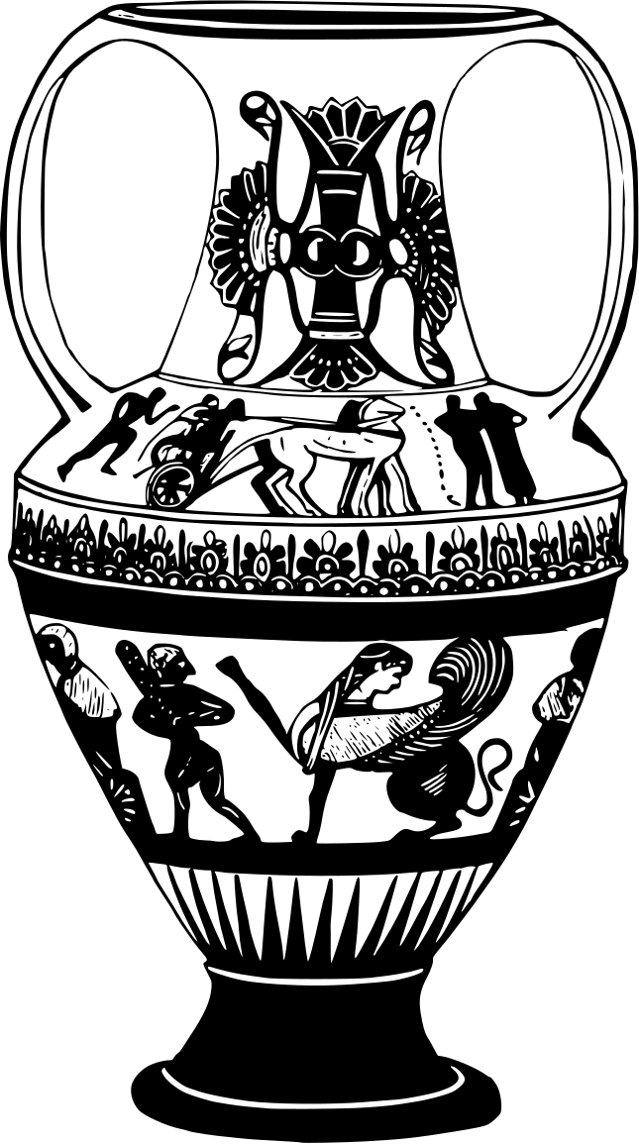
Thank
you!

